Slide 1
Introduction to Data Mining

Slide 2
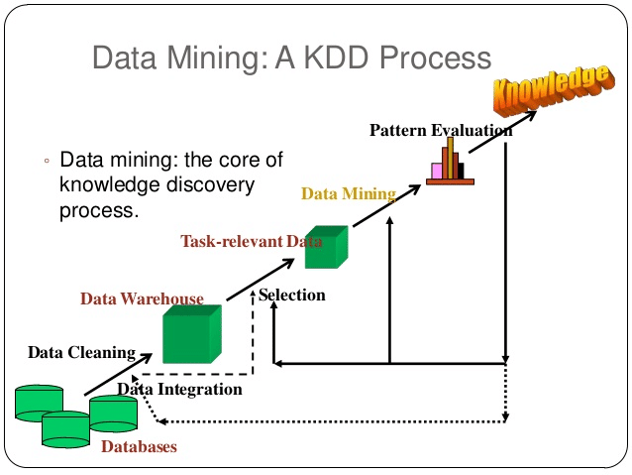
Content
Basic concepts of data mining,
Types of Data to be mined
Stages of the Data Mining Process
Data Mining Techniques
Knowledge Discovery in Databases
Data Mining Issues
Applications of Data mining

Slide 3
Data mining
Extraction of interesting (non-trivial, implicit, previously unknown and potentially useful) patterns or knowledge from huge amount of data
Alternative names
Knowledge discovery (mining) in databases (KDD)
knowledge extraction
data/pattern analysis
data archeology
information harvesting, business intelligence, etc.

Slide 4
What Kinds of Data Can Be Mined?
Data mining can be applied to any kind of data as long as the data are meaningful for a target application.
The most basic forms of data for mining Applications
Database data
Warehouse Data
transactional data

Slide 5
Mining Relational databases
Example : A relational database for Electronics store
customer (cust ID, name, address, age, occupation, annual income, credit information, category)
item (item ID, brand, category, type, price, place made, supplier)
employee (empl ID, name, category, group, salary, commission)
branch (branch ID, name, address)
purchases (trans ID, cust ID, empl ID, date, time, method paid, amount)
items_sold (trans ID, item ID, qty)
works_at (empl ID, branch ID)

Slide 6
Relational data can be accessed by database queries written in a relational query language (e.g., SQL).
Mining relational databases, we can go further by searching for trends or data patterns.
For example, data mining systems can analyze customer data to predict the credit risk of new customers based on their income, age, and previous credit information etc.

Slide 7
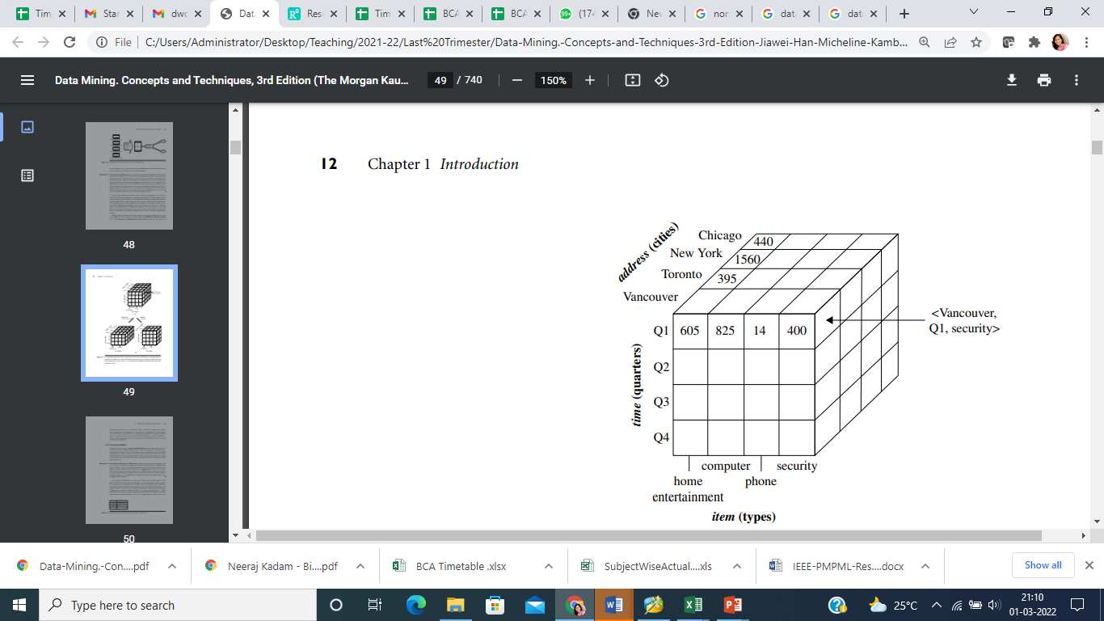
Mining Warehouse data
Example : A data warehouse for Electronics store

Slide 8
By providing multidimensional data views and the precomputation of summarized data, data warehouse systems can provide inherent support for OLAP.
Examples of OLAP operations include drill-down and roll-up, which allow the user to view the data at differing degrees of summarization
we can drill down on sales data summarized by quarter to see data summarized by month.
we can roll up on sales data summarized by city to view data summarized by country.

Slide 9
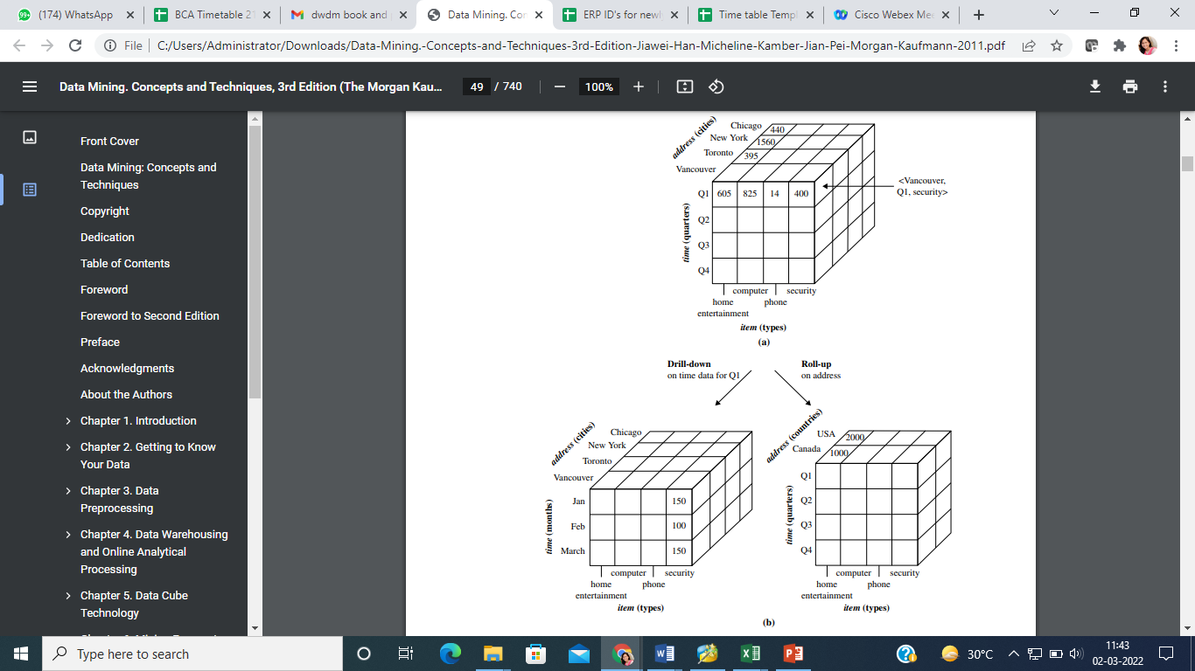

Slide 10
Mining Transactional Data
Each record in a transactional database captures a transaction, such as a customer’s purchase, a flight booking, or a user’s clicks on a web page etc
Example :
Transactions in ALLElctronics store database can be recorded as below
Transaction ID | Cust_ID | Items Purchased | Amount
T01 | C101 | I10,I11,I12 | 50000
T02 | C102 | I9 | 4000
T03 | C103 | I10,I12,I15 | 3000
T04 | C104 | I21, I22,I5 | 4000
T05 | c105 | I11,I12,I15 | 6000

Slide 11
Mining on above data could be “Which items sold well together” ?
A traditional database system is not able to perform market basket data analysis.
Fortunately, data mining on transactional data can do so by mining frequent itemsets,

Slide 12
Knowledge discovery process
KDD is the nontrivial extraction of implicit previously unknown and potentially useful knowledge from data
Knowledge
Pattern Evaluation
Data Mining
Data Transformation
Data Warehouses
Data Preprocessing
Data Integration
Data Cleaning
Selection
Operational Databases

Slide 13
Knowledge discovery in databases (KDD)
KDD is a multistep process of finding useful information and patterns
in data while Data Mining is one of the steps in KDD of using algorithms
for extraction of patterns

Slide 14
Steps Of KDD
1. Selection
Data Extraction - Obtaining Data from heterogeneous data sources -Databases, Data warehouses, World wide web or other information repositories
2. Preprocessing
Data Cleaning - Incomplete , noisy, inconsistent data to be cleaned- Missing data may be ignored or predicted, erroneous data may be deleted or corrected

Slide 15
3. Transformation
Data Integration- Combines data from multiple sources into a coherent store -Data can be encoded in common formats, normalized and reduced.
4. Data mining
Apply algorithms to transformed data to extract patterns
5. Pattern Interpretation/evaluation
Pattern Evaluation- Evaluate the interestingness of resulting patterns or apply interestingness measures to filter out discovered patterns Knowledge presentation- present the mined knowledge- visualization techniques can be used

Slide 16
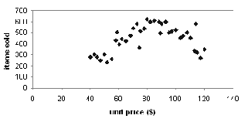
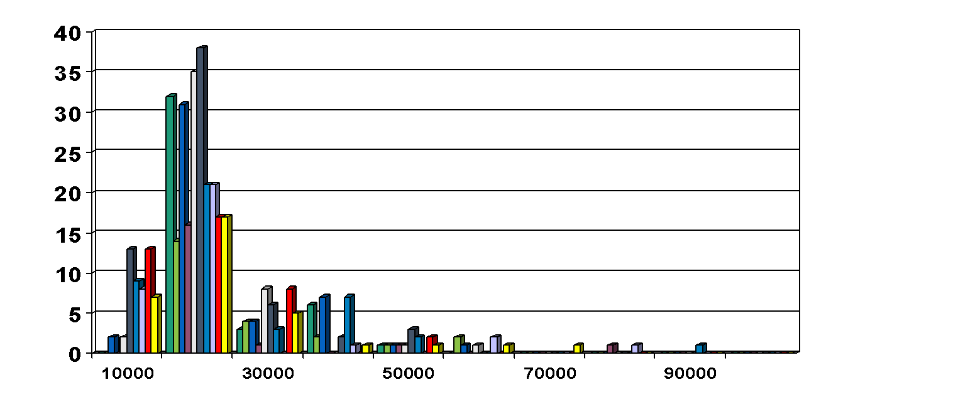
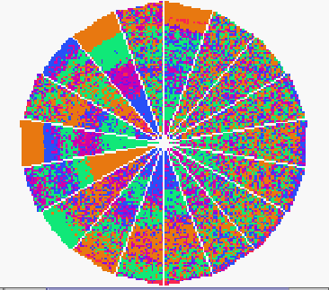
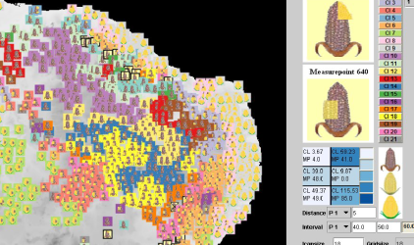
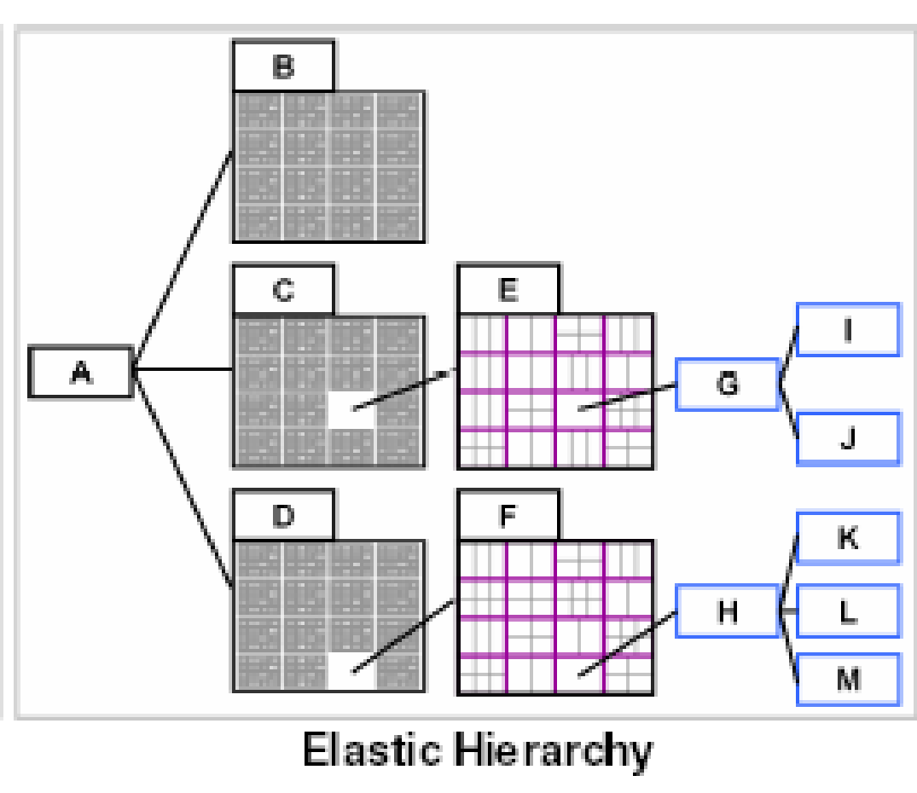
Visualization Techniques
Graphical-bar charts,pie charts histograms | Geometric-boxplot, scatter plot
Icon-based- using colors figures as icons | Pixel-based- data as colored pixels
Hierarchical- Hierarchically dividing display area | Hybrid- combination of above approaches

Slide 17
Data Mining – How ?
Different algorithms are used to accomplish Data mining tasks.
Algorithms consist of three parts
◦ Model – purpose of algorithm is to fit a model
to data
◦ Preference – criteria used to fit one model over
other
◦ Search – algorithms require some technique to
search data

Slide 18
Types of models :
Descriptive-characterize, explore properties of current data
Predictive-perform inference on current data to make predictions on future data

Slide 19
Data mining Techniques
Data Mining
Descriptive
Descriptive
Predictive
Descriptive
Predictive
Predictive
Clustering
Clustering
Clustering
Classification
Sequence Discovery
Sequence Discovery
Sequence Discovery
Prediction
Summarization
Prediction
Summarization
Prediction
Summarization
Regression
Association rules
Association rules
Association rules
Time series Analysis
Time series Analysis

Slide 20
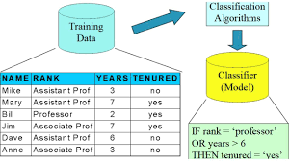
Classification
maps data into predefined groups or classes ,It uses supervised learning
The algorithm uses learning phase to build a classifier using training data set containing data attributes and associated class labels

Slide 21
Regression
A regression model determines a relationship between an independent variable and a dependent variable, by providing a function. Formulating a regression analysis helps you predict the effects of the independent variable on the dependent one.
Algorithm tries to find best function (linear, Non-linear that fits the training data)
Example: Relationship between body and height

Slide 22
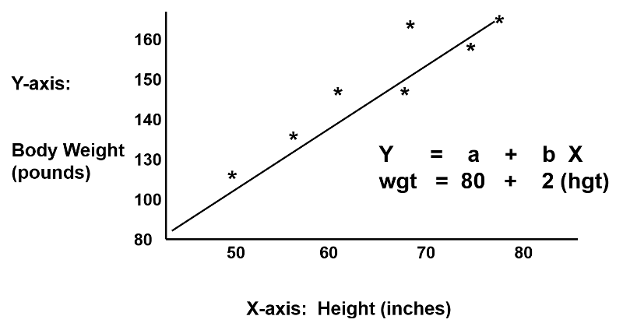

Slide 23
Time Series Analysis
the value of an attribute is examined as it varies over time
It can be used to determine similarities, classify the behavior or predict future values.
Time series analysis is used for non-stationary data—things that are constantly fluctuating over time or are affected by time.
Industries like finance, retail, and economics frequently use time series analysis because currency and sales are always changing.

Slide 24
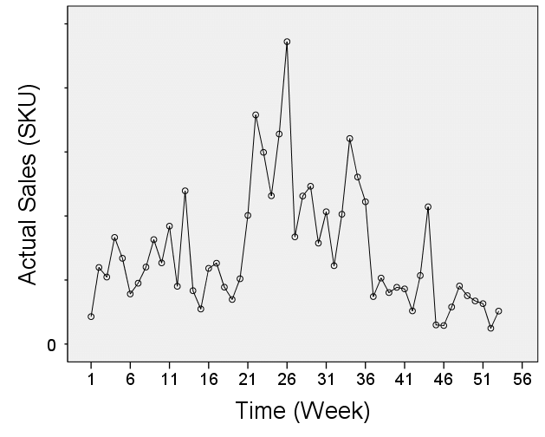

Slide 25
Prediction
predicts future values using regression, time series analysis or other approaches
Clustering –
Finding similarities between data according to the characteristics found in the data and grouping similar data objects into clusters
Unsupervised learning: no predefined classes Interpretability and usability-results should be comprehensible and usable-domain expert is required

Slide 26
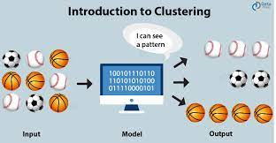

Slide 27
Summarization
The term Data Summarization refers to presenting the summary of generated data in an easily comprehensible and informative manner.
In general, data can be summarized numerically as a table (tabular summarization), or visually as a graph (data visualization).

Slide 28
Association rules
Discovers interesting relations between variables in large databases.
Example : Used in market basket analysis
Transaction Id | Items bought
TA | Bread, Butter, Juice
TB | Bread, Butter, Tea, Coffee
TC | Bread, Jam, Juice
TD | Tea, Coffee, Sugar
TE | Bread, Butter, Sugar

Slide 29
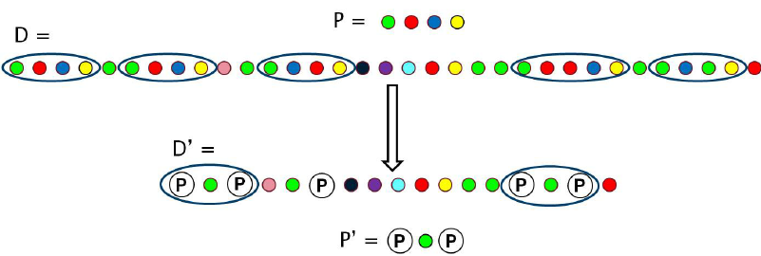
Sequence Discovery
discovers sequential patterns in data-order in which items are purchased or data is accessed

Slide 30
Data mining issues
Human interaction- interfaces required with both domain and technical experts- variety of databases, variety of users leading to numerous data mining techniques – What is required is not known hence extraction process need to be interactive.
Interpretation of results- requirements of experts- interpretability problems- Background knowledge or domain expertise is essential to guide the discovery process
visualization of results- visualization helps- multi-dimensional data is problematic – The discovered knowledge should expressed in the form of trees , tables, graphs, charts curves etc.

Slide 31
Data mining issues
Large datasets- scalability is a problem- algorithms do not scale well with massive real-world datasets- sampling and parallelization are effective tools
High dimensionality -Conventional database may contain many different attributes, all are not relevant-increases complexity and reduces efficiency –dimensionality curse-data reduction-dimensionality reduction
Multimedia data – image, audio, video, GIS data - proves conventional data mining algorithms ineffective
Missing data -It is not always possible to ignore missing data but in preprocessing data mining algorithms can be used to replace missing data with estimates

Slide 32
Data mining issues
Irrelevant data – Data reduced by removing irrelevant data
Noisy data–Invalid , incorrect data will lead to poor quality data mining
Outliers – The model may get distorted because of the presence of outliers
Overfitting – It occurs when the model fits the current data exactly but does not fit future data - can be due to wrong choice of training data set

Slide 33
Changing data- Data warehouses contain non-volatile data-Dynamic data is uploaded and then algorithms are reapplied
Applications – Effective use of output of mining algorithm is a challenge rather than the complexity of the mining algorithm

Slide 34
Large datasets- scalability is a problem- algorithms do not scale well with massive real-world datasets- sampling and parallelization are effective tools
High dimensionality -Conventional database may contain many different attributes, all are not relevant-increases complexity and reduces efficiency –dimensionality curse-data reduction-dimensionality reduction
Multimedia data – image, audio, video, GIS data - proves conventional data mining algorithms ineffective
Missing data -It is not always possible to ignore missing data but in preprocessing data mining algorithms can be used to replace missing data with estimates

Slide 35
Why Data Mining?—Potential Applications
Data analysis and decision support
Market analysis and management
Target marketing, customer relationship management (CRM), market basket analysis, cross selling, market segmentation
Risk analysis and management
Forecasting, customer retention, improved underwriting, quality control, competitive analysis
Fraud detection and detection of unusual patterns (outliers)
Other Applications
Text mining (news group, email, documents) and Web mining
Stream data mining
Bioinformatics and bio-data analysis

Slide 36
Market Analysis and Management
Where does the data come from?—Credit card transactions, loyalty cards, discount coupons, customer complaint calls, plus (public) lifestyle studies
Target marketing
Find clusters of “model” customers who share the same characteristics: interest, income level, spending habits, etc.,
Determine customer purchasing patterns over time
Cross-market analysis —Find associations/co-relations between product sales, & predict based on such association
Customer profiling —What types of customers buy what products (clustering or classification)
Customer requirement analysis
Identify the best products for different customers
Predict what factors will attract new customers
Provision of summary information
Multidimensional summary reports
Statistical summary information (data central tendency and variation)

Slide 37
Corporate Analysis & Risk Management
Finance planning and asset evaluation
cash flow analysis and prediction
contingent claim analysis to evaluate assets
cross-sectional and time series analysis (financial-ratio, trend analysis, etc.)
Resource planning
summarize and compare the resources and spending
Competition
monitor competitors and market directions
group customers into classes and a class-based pricing procedure
set pricing strategy in a highly competitive market

Slide 38
Fraud Detection & Mining Unusual Patterns
Applications: Health care, retail, credit card service, telecomm.
Auto insurance: ring of collisions
Money laundering: suspicious monetary transactions
Medical insurance
Professional patients, ring of doctors, and ring of references
Unnecessary or correlated screening tests
Telecommunications: phone-call fraud
Phone call model: destination of the call, duration, time of day or week. Analyze patterns that deviate from an expected norm
Retail industry
Analysts estimate that 38% of retail shrink is due to dishonest employees
Anti-terrorism

Slide 39
Revise
Define Data mining
List data mining techniques
Explain state and explain data mining techniques(all techniques)
State and explain KDD steps
State and explain any five data mining issues
State and explain any five data mining applications

